Slide 1
SPRINT 1 STATUS UPDATE FINAL
Integrating data catalogs with content search technologies
Team Name: Mindbots
Week 4
Date 02/13/23

Slide 2
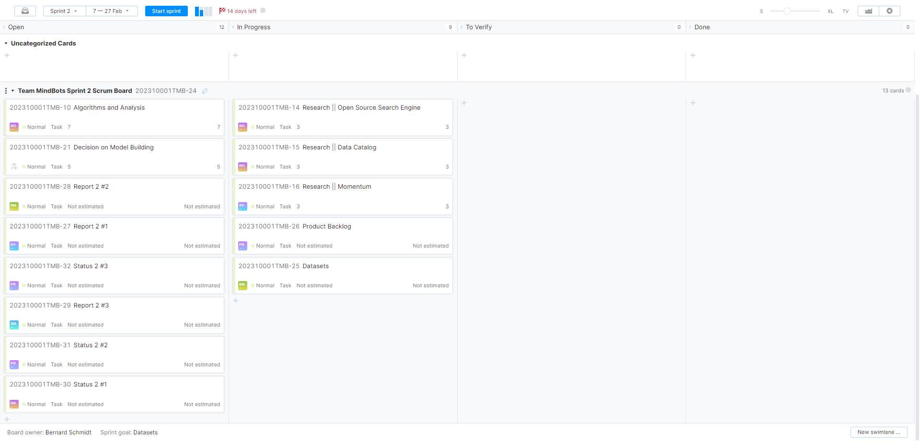
YOUTRACK

Slide 3






TEAM MEMBERS
Bhavana Macha Developer
Bhavana Macha Developer
Oddiraju
Sahithi Developer
Saiprem Vemulapalli Developer
Saiprem Vemulapalli Developer
Sachin Mote Developer
Sachin Mote Developer
Prakruti Kothari Product Owner
Prakruti Kothari Product Owner
Ravinder singh Scrum Master
Ravinder singh Scrum Master

Slide 4
PROBLEM STATEMENT
Problem Context:
Domain of problem: Multiple domains
Importance of problem: Useful in enabling quick access to metadata by minimizing the cost utilized for data catalog tools
Problem Statement:
Search engines with data catalogs do not use features like best-fit-tags and ranking of the tags.
Populate and Track the tags
Ranking of the tags using ranking algorithm for the best fit match.
Some of the best features of search engines are scalability, security and integration. Whereas features of data cataloging are best-fit tags and ranking of tags. Despite having a lot of search engines and data catalogs, there isn’t one that uses each other’s best features.

Slide 5
DATASETS
Proposed Datasets for Project
Dataset Name:
Answer Prediction Dataset
Tweets Blogs News – Swift-key Dataset 4million
BBC News
Twitter-News

Slide 6
OBJECTIVES
· Objective 1. Determine Best Fit Tags
Sub-Objective 1a: Search Engine feed metadata tags
Sub-Objective 1b:Data Catalog feed metadata tags
Sub-Objective 1c: Determine “best” descriptors for data resource
· Objective 2. Integrate Search Engine w/ Data Catalog
· Objective 3. Data Catalog provide “has access” indicators
Enable "has access" indicators

Slide 7
POTENTIAL ANALYTICS/ALGORITHMS
Analytic/Algorithm Name: Yet to be discussed.
Software: Momentum by Accure AI, Apache Lucene, OpenMetadata
Computer Resources Required: large CPU; GPU; cloud resources(AWS to run Momentum); laptop; etc.
Training: if applicable
Optimization: if applicable
Testing: if applicable

Slide 8
PROJECT SCHEDULE
Task | Date | Status
Form Teams | 01/24/2023 | Completed
Gather Project Info | 01/26/2023 | Completed
Get Familiar with Agile & Scrum | 01/27/2023 | Completed
Meeting with Instructor | 01/30/2023 | Completed
Problem Statement | 02/01/2023 | Completed
Gather & Understanding Data | 02/03/2023 | Completed
Get Access to Momentum | 02/05/2023 | Completed
Make a list of algorithm | TBD | Pending
Decision on Model Building | TBD | Pending
*Tentative Schedule

Slide 9
RISKS AND PLANNED MITIGATIONS
Risk Name | Description | Probability | Impact | Mitigation
Connectivity | Connecting data and results from one Software to Other which are on different Hosts. | 20%-50% | Medium | Try to mitigate the risk by going through the docs, research and advices.
Privacy | A normal user using the search engine might access high level results produced by the search engine. | 60% | High | Using levels of authorization can help us control the access and hence increase the privacy
Notes:
Risk Description: The tools when loaded with a humongous number of metadata, breakdown due to performance issues and some tools can only accommodate a limited amount of metadata on data assets. The evaluation by technical experts in the data cataloging team before implementation is very important as it could prove very costly in the later stages of the project.
Mitigation: The evaluation by technical experts in the data cataloging team before implementation is very important as it could prove very costly in the later stages of the project.

Slide 10
WEEKLY PARTNER MEETING
Partner name [Primary Partner POC]
Team Progress from Prior Week
Team Tasks for Current Week
Other Items Discussed

